Slide 1
Realizing a carbon neutral economy: A new governance framework 2030 | 2040 | 2050
Background Information
for 25 June 2021 Meeting
For discussion and prepared by
Ann Dale & Evert Lindquist

Slide 2
Agenda for June 25th Meeting 10-11 am via Zoom at: https://uvic.zoom.us/j/83338550247
Welcome & introductions
Questions arising from last meeting
Start-date, pacing, responsibilities
Review of climate action frameworks (#1)
Case studies: preliminary discussion (#2)
Pacing of meetings for Fall 2021

Slide 3
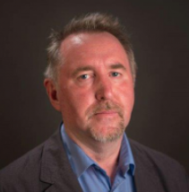
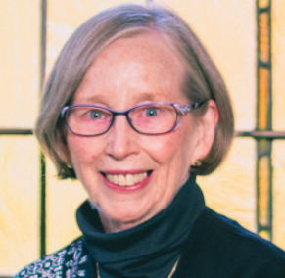
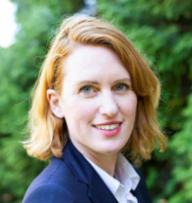
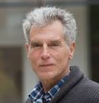
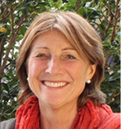
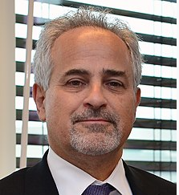
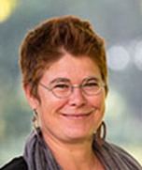
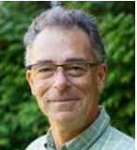
Our Research Team
Ann Dale Professor in the School of Environment and Sustainability at RRU, bring extensive knowledge of government as a former executive of the federal government for over twenty years, with expertise in strategic policy development and new government administration. Examples include the creation of the NRTEE and advising on provincial round tables; the creation of the first federal department to be created outside of Ottawa, the Atlantic Canada Opportunities Agency; several federal/private sector task forces looking at regulatory reform; and natural resource management and machinery of government reform. She held RRUs’ first CRC in sustainable community development (2004-2014), is a Trudeau Alumna, and a Fellow of the World Academy of Art and Sciences. | Ken Christie Professor in the Human Security and Conflict graduate programs at RRU. Christie is a political scientist, author, editor and international academic who has taught and conducted research at universities in the US, Singapore, South Africa, Norway and Dubai. Working all over the world has given him a unique perspective on peace, development and human security, and governance systems. His work has focused on issues of human rights, security and democratization. He is widely published as an author and editor with eight books to his credit. Currently he is working on issues of religion, ethnic and state formation/failure in the Middle East, North Africa and South Asia. He has also conducted evaluations of human rights NGOs for the Norwegian government in Southeast Asia. | Leslie King Professor of Environment and Sustainability at RRU. She has extensive interdisciplinary experience to the team. Most recent research projects include: Conflicting Knowledge Systems in the Pacific Northwest; Meeting the Climate Change Challenge (MC3), Protected Areas and Poverty Reduction: A Canada Africa Research and Learning Alliance, (PAPR); Arctic Climate Predictions: Pathways to Sustainable Resilient Societies (ARCPATH); and Northern Knowledge for Resilience, Sustainable Environments and Adaptation in Coastal Communities in the Circumpolar Arctic (NORSEACC). Led synthesis processes for large complex inter-disciplinary, international research projects, e.g. the 10-year IHDP project; & Inst. Dimensions of Global Environmental Change (IDGEC). | Tamara Krawchenko Assistant Professor at the School of Public Administration at UVic. She studies public policy from an interdisciplinary and multi-level governance perspective at multiple scales—from international frameworks to local politics. Her research interests include: political economy and economic geography; comparative public policy; land use planning and strategic spatial planning; community and economic development; territorial policies (regional, rural, urban); and transportation and infrastructure policy. Her multi-disciplinary research has covered topics ranging from rural development, to the governance of land use, infrastructure policy, intergenerational equity and public finance. She has authored over 50 articles, books and reports. | Tad Homer-Dixon Founder and Director, Cascade Institute. An internationally recognized scholar, his research focuses on threats to global security in the 21st century, including economic instability, climate change, and energy scarcity. He also studies how people, organizations, and societies can better resolve their conflicts and innovate in response to complex problems.
Morris Rosenberg With a long and distinguished career in the federal public ervice. He worked in the Department of Justice from 1979 to 1989 and then was appointed Assistant Deputy Minister in the Department of Consumer and Corporate Affairs. From 1993 to 1996, he was ssistant Secretary to the Cabinet, Economic and Regional Development Policy, at the Privy Council ffice. He was appointed Deputy Secretary to the Cabinet (Operations) in 1996. Two years later, he was appointed Deputy Minister of Justice and Deputy Attorney General of Canada, a post he held for six years. He was appointed Deputy Minister of Health Canada from 2004 to 2010 when he became Deputy Minister of Foreign Affairs. He served as President and CEO of the Pierre Elliott Trudeau Foundation.. | Astrid Brousselle Professor and Director of UVic’s School of Public Administration, her main expertise is in evaluation theories and methods in healthcare and healthcare system analysis. In her career, she has published over 60 scientific articles and she co-wrote and co-edited a book (in 2009), L’Évaluation: Concepts et Méthodes. Recently she published two comments in The Lancet Planetary Health about the ecosocial transition. Before taking a leadership role at UVic, she held a Canada Research Chair in Evaluation approaches and health system analysis. She led with Tara Ney and Lisa Helps, Mayor of Victoria, the Vancouver Island Climate Action Leadership Plan research project, and current research focused on identifying approaches for accelerating the ecological transition. | Emmanuel Brunet-Jailly Professor at the School of Public Administration at UVic, holds a Jean Monnet Chair in Innovative Governance (2017-20), and is an expert in multi-level governance. He worked for the French public sector for ten years, including postings with the French Small Business Administration and the Nord Pas-de-Calais Regional Council, which involved working with the EC and the EU Directorate for Regional Policies in Brussels. At Uvic he was the Jean Monnet Chair in European Urban and Border Region Policy (2014-16), Editor of the Journal of Borderland Studies, Director of the Borders In Globalization research program (2013-20) funded by a $2.4 million SSHRC Partnership Grant, and Director of the EU Jean Monnet Center & Jean Monnet Network research programs (2013-19). | Katya Rhodes Assistant Professor in UVIc’s School of Public Administration, she was Senior Economic Advisor in the BC Climate Action Secretariat, leading economic analyses for the CleanBC plan, and taught environmental economics at RRU. She conducted research on economic efficiency, environ. effectiveness, and political acceptance of BC’s climate policies. Her research skills include descriptive and inferential statistical analyses, energy-economy modeling, collection and parameterization of survey data, media and content analysis. She developed clean technology and green jobs databases at the Van. Econ. Commission, analyzed provincial policy for MFLNRO’s Cumulative Effects Framework, and investigated public and stakeholder views of BC’s carbon tax at the Pembina Institute. | Tara Ney An Associate Professor of Public Administration at UVic, Ney is an expert in designing inclusive and effective decision-making processes in organizations and communities. Prior to joining UVic, she worked in the government, non-profit, and private sectors as a clinical and forensic psychologist, with extensive experience in community development, locally in restorative justice programming and internationally in post-conflict zones. Since 2008 she has served as a municipal councilor in Oak Bay. Ney is involved with the Vancouver Island Climate Action Leadership Plan project and and Co-constructing Justice: Citizen-centered design for public services complaint systems, funded by SSHRC.
Evert Lindquist
Professor of Public Administration at UVic and Editor of IPAC’s journal Canadian Public Administration since 2012, former President of the Canadian Association of Programs in Public Administration and former SPA Director. Published on public sector reform, governance and decision-making, central agencies, policy capability, think tanks, consultation, horizontal management, leadership and competing values, and visualization.

Slide 4
Objectives, Activities, Methods
Objectives
Synthesize/articulate governance frameworks for Canada
Develop and analyze case studies on responses to global crises
Assess Canada’s climate actions & sustainability strategies
Determine needed governance and institutional capacities
Develop framework for monitoring climate action progress
Develop integrated governance & public administration mix
Knowledge mobilization
Upstream
Downstream
Research team
Working paper
Publications
1 Review of climate action governance frameworks
Interviews & focus groups
2 Cases Studies Literature Reviews
5 Develop integrated governance & public administration mix
6 Develop framework for monitoring progress on climate action goals
3 Assess Canada’s current strategies
4 Determine needed governance and institutional capacities

Slide 5
Our Deliverables
7 Publications
1 Review of climate action governance frameworks
Interviews & focus groups
2 Cases based on Literature Reviews
5 Develop integrated governance & public administration mix
6 Develop framework for monitoring progress on climate action goals
3 Assess Canada’s current strategies
4 Determine needed governance and institutional capacities
= Journal articles
= Special issues or collection

Slide 6
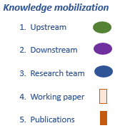
Notional Timelines for a Four-Year Grant
2021
2022
2023
2024
2025
1. Review of
climate action governance frameworks
6. Develop framework for monitoring progress on climate action goals
2. Cases based on Literature Reviews
Interviews & focus groups
5. Develop integrated governance & public administration mix
18
June
2021
Interviews & focus groups
3. Assess Canada’s current strategies
4. Determine needed governance and institutional capacities
Special issue
or collection

Slide 7
Next Steps for Year 1 (2021-2022)
Confirm start-date: September 2021
Submit ethics application to Provincial Research Ethics Platform
Explore steps for sub-grant from RRU to UVic
Proposed Year 1 priorities:
Review of climate-action governance frameworks (Fall 2021)
Identify/finalize case-study topics; ethics review (Fall 2021)
Advertise for & engage post-doctoral fellow or PhD project manager (Fall 2021)
Recruit PhD/MPA students for case-study research (Fall 2021)
Approve case-study lit. review & interview protocol (Fall 2021)
Carry out first round of four case studies (Spring 2022)
Prepare: Assessing Canada’s current climate strategies (Spring 2022)
Focus of June 25 meeting:
Finalize first-round case-study topics
Approve of general plan/deliverables/team meetings
How often would you like to meet in Fall 2021? Should we schedule standing meetings?

Slide 8
Roles and Responsibilities
Synthesize & articulate governance frameworks for Canada
RRU (Ann/Leslie) to review the literature & prepare framework for consideration by team (Fall 2021)
This ‘going in’ framework will frame case study protocol & assessments of current strategies
RRU/UVic colleagues participate in successive team & ‘external’ knowledge mobilization events
Develop/analyse case studies on responses to global crises
UVic takes lead: EL to coordinate; faculty supervise graduate students; organize related events
RRU takes lead: ethical review submission to Provincial Research Ethics Platform (PREP)
Assess Canada’s climate actions & sustainability strategies
RRU takes lead: AD works with post-doctoral student; organize related events
Determine needed governance & institutional capacities
UVic takes lead but joint RRU/UVic dialogues w research team and with practitioners
Develop a framework for monitoring progress
UVic takes lead: EL works performance monitoring specialist; organize related events
Journal article publications & possible OA collection
UVic takes lead: EL/AD coordinate; but lead supervisors/researchers are lead authors
UVic takes lead on publishing a collection (either book proposal or special issue)
Knowledge mobilization and communications
RRU takes lead: AD works with post-doc to organize stakeholder events & communications
Team members are encourage to blog and use social media as we proceed
“Lead” does not mean “own” because requisite expertise may variously rest in different institutions, and all products will come to the team, but involves taking responsibility for ensuring things are done.

Slide 9
Candidates for Cases
Evidence criteria:
coalition building
strategic partnerships
regime formation
a priori network formation
diversity and scale of actors
number of institutions & policy instruments coordinated; and
nature of institutions…
vertical
horizontal
boundary spanning
policy coherence…
alignment within and between instruments
quasi-institutional intermediaries
impact; effectiveness; time-frame
cost, efficiency, monitoring
National and international scale
COVID-19
911
H1N1
Non-governmental campaigns
Inter. Campaign to Ban Landmines
350.org
Extinction Rebellion
Greta Thunberg’s School Strike
Major environmental campaigns
Acid rain
depletion of the ozone layer
Other potential cases
x
x
x
x
x

Slide 10
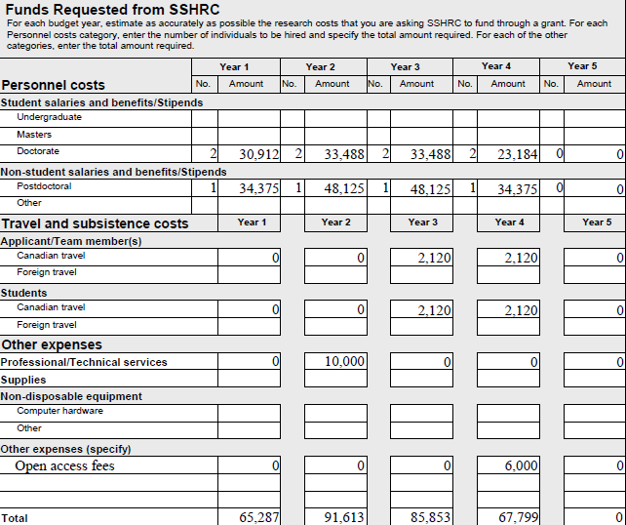
Budget Envelope
Total grant authorized is
$300,552 over 4 years
Primarily for undertaking research on and writing up case studies, but also for literature reviews and assisting with publications.
Need to develop a digital platform for managing the project, which will require hiring someone with sufficient expertise.
Perhaps increase this amount for several open access articles and/or a special issue in a journal.
Received
Reduced by $10k

